Slide 2

Question Pairs
Sukanya Behera [160714733008]
Chandrabhatta Sriram [160713733042]
Abul Faiz Mohammed Abdul Hadi Mouzzam [160714733108]
Project Guide: E. Shailaja [Asst. Prof. Dept. of CSE]

Slide 3
Abstract
Quora is a place to gain and share knowledge—about anything. It’s a platform to ask questions and connect with people who contribute unique insights and quality answers.
Over 100 million people visit Quora every month, so it's no surprise that many people ask similarly worded questions. Multiple questions with the same intent can cause seekers to spend more time finding the best answer to their question(s), and make writers feel they need to answer multiple versions of the same question.
The goal is to predict which of the provided pairs of questions contain two questions with the same meaning.

Slide 4
Introduction [Problem Definition]
More formally, the duplicate question detection problem can be defined as follows: given a pair of questions q1 and q2, train a model that learns the function:
  f(q1, q2) → 0 or 1
  where 1 represents that q1 and q2 have the same intent and 0 otherwise.

Slide 5
Let’s Talk Data, Shall We?
The Dataset being analysed/solved is taken from kaggle.com (a popular website for hosting data science/mining competitions), which was provided by Quora.
It contains more than 400,000 data points.
File Type: .CSV [Comma Separated Value].
File Size: 130 Mega Bytes [Uncompressed].

Slide 6
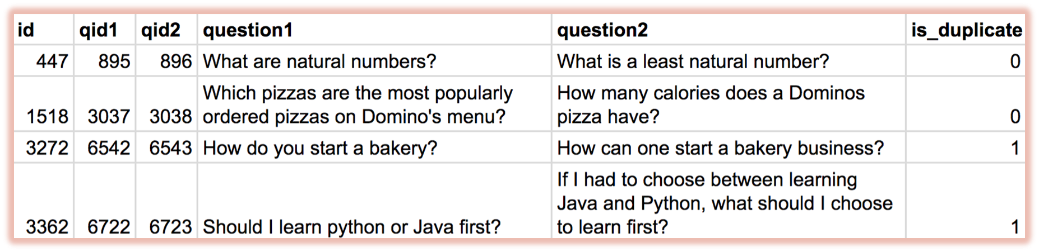
Dataset Snapshot

Slide 7
Existing System
The Existing System had a production model for solving this problem as a Random Forest Model with tens of handcrafted features, including:
  the number of common words,
  the number of common topics labelled on the questions,
  and the part-of-speech tags of the words.

Slide 8
Proposed System
The Proposed System will be a first cut solution to predict whether the given questions are similar or not, using ML & AI techniques like:
  Exploratory Data Analysis [summarizing the main characteristics of data, using scatter plots].
  Dimensionality Reduction [extraction of Principle Variables, by eliminating some dimensions/data points].
  Data Classification & Regression techniques to classify our data.

Slide 9
Algorithms & Technologies Used
Some of the Machine Learning Algorithms used are:
  Linear Regression,
  Probability, Statistics, Linear Algebra,
  k – Nearest Neighbours, etc.
Technologies used:
  Python 3.6.x with Anaconda Package Manager.
  Code will be written and documented in Jupyter Notebooks [formerly known as “iPython Notebooks”].
  Machine Learning Packages used are:
    numpy, matplotlib, pandas, scipy, etc.

Slide 10
Thank You!

Slide 11
Any Questions/Queries?

